Slide 1
Multiple Access Techniques I
Course Code: CSC 3116
Course Title: Computer Networks
Dept. of Computer Science
Faculty of Science and Technology
Lecturer No: | 3 | Week No: | 3 | Semester: | Summer 23-24
Lecturer: | Md. Faruk Abdullah Al Sohan; faruk.sohan@aiub.edu

Slide 2
Multiple Access Techniques
Introduction
Channelization Protocols
FDMA
TDMA
CDMA
Controlled Access
Reservation
Pooling
Token-passing

Slide 3
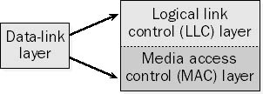
Introduction
Two sublayers:
LLC (Logical Link Control) sublayer
MAC (Medium Access Control) sublayer
The upper sublayer that is responsible for flow and error control is called the logical link control (LLC) layer;
The lower sublayer that is mostly responsible for multiple access resolution is called the media access control (MAC) layer. When nodes or stations are connected and use a common link, called a multipoint or broadcast link, we need a multiple-access protocol to coordinate access to the link [1].

Slide 4
Introduction….
Multiple access networks – multiple sending & receiving stations share the same transmission medium. Examples: LAN, cellular and satellite networks
Advantages:
low-cost infrastructure
all stations attached to the medium hear
transmission from any other station ⇒ routing not necessary
Disadvantages:
access of multiple sending and receiving nodes to the shared medium must be coordinated
stations should not be transmitting simultaneously or interrupting each other
stations should not be able to ‘monopolize’ the transmission/shared medium

Slide 5
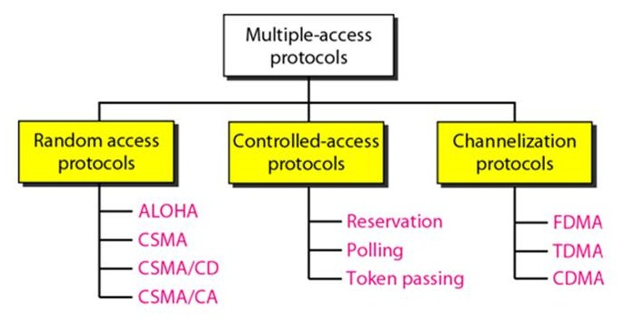
Introduction….
Fig. 1 Classification of multiple access protocols [1]

Slide 6
Channelization Protocols
Classification
Channelization is a multiple access method in which the available bandwidth of a link is shared in time, frequency or code between different stations.
There are three basic channelization protocols:
Frequency Division Multiple Access (FDMA)
Time Division Multiple Access (TDMA)
Code Division Multiple Access (CDMA)

Slide 7
Channelization Protocols….
FDMA
In FDMA, the available bandwidth is divided into frequency bands.
Each station is allocated a band to send its data.
This band is reserved for that station for all the time.
The frequency bands of different stations are separated by small bands of unused frequency.
These unused bands are called guard bands that prevent station interferences.
Example: Different Radio Stations

Slide 8
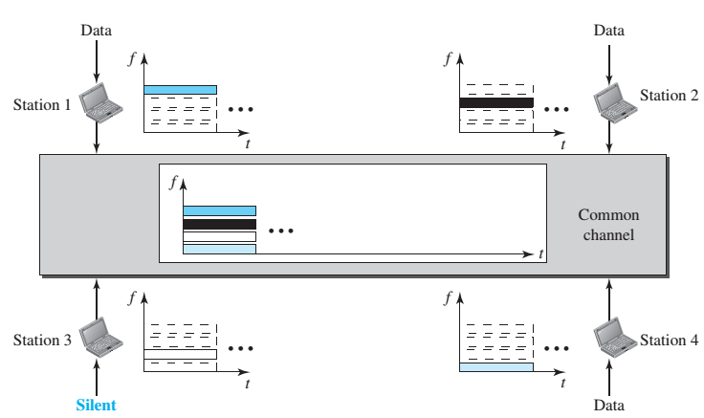
Channelization Protocols….
FDMA
Fig. 2 Illustration of FDMA [1]

Slide 9
Channelization Protocols….
TDMA
In TDMA, the bandwidth of channel is divided among various stations based on time.
Each station is allocated a time slot during which it can send its data.
Each station must know the beginning of its time slot.
TDMA requires synchronization between different stations.
Synchronization is achieved by using some synchronization bits at the beginning of each slot [1].
Example: Class timing

Slide 10
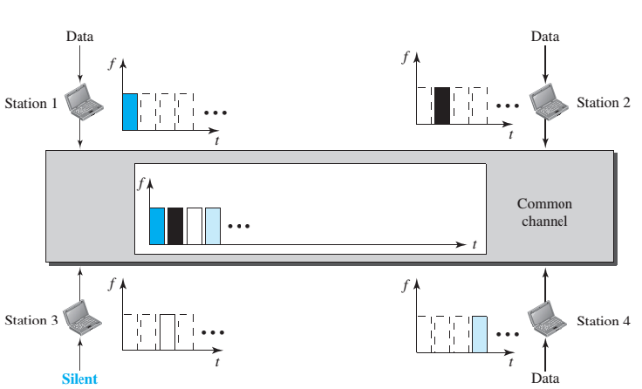
Channelization Protocols….
TDMA
Fig. 3 Illustration of TDMA [1]

Slide 11
Channelization Protocols….
CDMA
Unlike TDMA, in CDMA all stations can transmit data simultaneously.
CDMA allows each station to transmit over the entire frequency spectrum all the time.
Multiple simultaneous transmissions are separated using coding theory.
In CDMA, each user is given a unique code sequence [1].
Example: A party theme

Slide 12
Working process of CDMA
Let us assume that we have 4 stations: 1, 2, 3 and 4; those are connected to the same channel.
The data from station 1 is d1, from station 2 is d2 and so on.
The code assigned to station 1 is c1, station c2 and so on.
These assigned codes have two properties:
If we multiply each code by another, we get 0
If we multiply each code by itself, we get 4 (no of stations)

Slide 13
Working process of CDMA
When these four stations send data on the same channel., then station 1 multiplies its data by its code i.e. d1c1, station 2 multiplies its data by its code i.e., d2c2 and so on.
The data that goes on the chancel is the sum of all these terms:
d1c1 + d2c2 + d3c3 + d4c4
Any station that wants to receive data from the channel multiplies the data on the channel by the code of the sender.

Slide 14
Working process of CDMA
For e.g., suppose station 2 wants to receive data from station 1
It multiplies the data on the channel by c1, (code of station 1)
Because (c1, c1) is 4, but (c2, c1), (c3,c1) and (c4,c1) are all 0s, station 2 divides the result by 4 to get the data from station 1.
data = (d1c1 + d2c2 + d3c3 + d4c4).c1
= d1.c1.c1 + d2.c2.c1 + d3.c3.c1 + d4.c4.c1
= d1.4 + 0 + 0 + 0
=(d1.4)/4 = d1

Slide 15
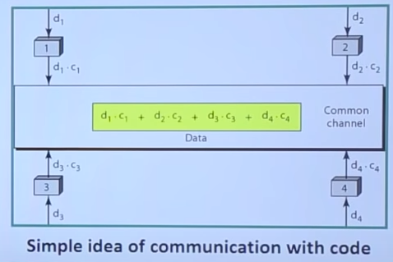
CDMA

Slide 16



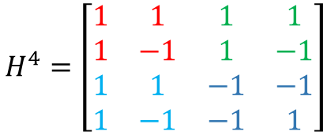


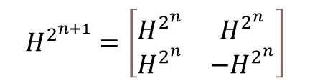
Channelization Protocols….
CDMA
How to generate codes using Hadamard Matrix?
$$H=\left[1\right]$$
Each row of H is a code of a user.
Codes are orthogonal to each other. That is, multiplying
any two code results in a zero.
$$H^{2^{n+1}}=\left[\begin{matrix}H^{2^{n}} & H^{2^{n}} \\ H^{2^{n}} & −H^{2^{n}}\end{matrix}\right]$$
$$H^{8}=\left[\begin{matrix}H^{4} & H^{4} \\ H^{4} & {−H}^{4}\end{matrix}\right]$$
$$H^{2}=\left[\begin{matrix}1 & 1 \\ 1 & −1\end{matrix}\right]$$
$$H^{8}=\left[\begin{matrix}1 & 1 & 1 & 1 & 1 & 1 & 1 & 1 \\ 1 & −1 & 1 & −1 & 1 & −1 & 1 & −1 \\ 1 & 1 & −1 & −1 & 1 & 1 & −1 & −1 \\ 1 & −1 & −1 & 1 & 1 & −1 & −1 & 1 \\ 1 & 1 & 1 & 1 & −1 & −1 & −1 & −1 \\ 1 & −1 & 1 & −1 & −1 & 1 & −1 & 1 \\ 1 & 1 & −1 & −1 & −1 & −1 & 1 & 1 \\ 1 & −1 & −1 & 1 & −1 & 1 & 1 & −1\end{matrix}\right]$$
H⁴
H⁴
$$H^{4}=\left[\begin{matrix}H^{2} & H^{2} \\ H^{2} & {−H}^{2}\end{matrix}\right]$$
$$H^{4}=\left[\begin{matrix}1 & 1 & 1 & 1 \\ 1 & −1 & 1 & −1 \\ 1 & 1 & −1 & −1 \\ 1 & −1 & −1 & 1\end{matrix}\right]$$
H⁴
-H⁴

Slide 17
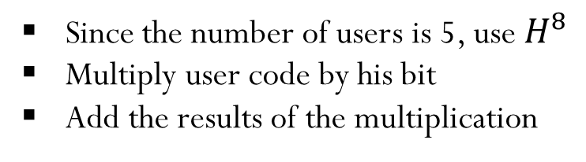
Channelization Protocols….
CDMA
Suppose there are five users A, B, C, D and E. They want to send 0, +1, +1, -1, -1 bits, respectively. Generate the code for each user and find the transmit sequence. Suppose that a user G wants to decode the information sent from the user B. How can he do this?
Since the number of users is 5, use $H^{8}$
Multiply user code by his bit
Add the results of the multiplication

Slide 18





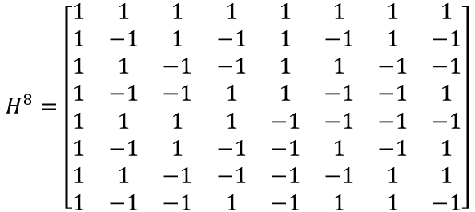
Channelization Protocols….
CDMA
$$0×R1=$$
$$\left[\begin{matrix}0 & 0 & 0 & 0 & 0 & 0 & 0 & 0\end{matrix}\right]$$
$$H^{8}=\left[\begin{matrix}1 & 1 & 1 & 1 & 1 & 1 & 1 & 1 \\ 1 & −1 & 1 & −1 & 1 & −1 & 1 & −1 \\ 1 & 1 & −1 & −1 & 1 & 1 & −1 & −1 \\ 1 & −1 & −1 & 1 & 1 & −1 & −1 & 1 \\ 1 & 1 & 1 & 1 & −1 & −1 & −1 & −1 \\ 1 & −1 & 1 & −1 & −1 & 1 & −1 & 1 \\ 1 & 1 & −1 & −1 & −1 & −1 & 1 & 1 \\ 1 & −1 & −1 & 1 & −1 & 1 & 1 & −1\end{matrix}\right]$$
$$1×R2=$$
$$\left[\begin{matrix}1 & −1 & 1 & −1 & 1 & −1 & 1 & −1\end{matrix}\right]$$
$$1×R3=$$
$$\left[\begin{matrix}1 & 1 & −1 & −1 & 1 & 1 & −1 & −1\end{matrix}\right]$$
$$−1×R4=$$
$$\left[\begin{matrix}−1 & 1 & 1 & −1 & −1 & 1 & 1 & −1\end{matrix}\right]$$
$$−1×R5=$$
$$\left[\begin{matrix}−1 & −1 & −1 & −1 & 1 & 1 & 1 & 1\end{matrix}\right]$$
$$\left[\begin{matrix}0 & 0 & 0 & −4 & 2 & 2 & 2 & −2\end{matrix}\right]$$
Transmit sequence:
$$\left[\begin{matrix}0 & 0 & 0 & −4 & 2 & 2 & 2 & −2\end{matrix}\right]$$

Slide 19
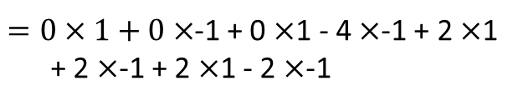




Channelization Protocols….
CDMA
Recovery of the bit sent from user B
$$Received sequence×Desired user^{′}s \left(B^{′}s\right) code$$
$$\left[\begin{matrix}0 & 0 & 0 & −4 & 2 & 2 & 2 & −2\end{matrix}\right]$$
$$×$$
$$\left[\begin{matrix}1 & −1 & 1 & −1 & 1 & −1 & 1 & −1\end{matrix}\right]$$
$$\left[\begin{matrix}0 & 0 & 0 & −4 & 2 & 2 & 2 & −2\end{matrix}\right]$$
$$\left[\begin{matrix}1 \\ −1 \\ 1 \\ −1 \\ 1 \\ −1 \\ 1 \\ −1\end{matrix}\right]$$
$=0×1+0×$-1 + 0 $×$1 - 4 $×$-1 + 2 $×$1
+ 2 $×$-1 + 2 $×$1 - 2 $×$-1
$=0+0$ + 0 + 4 + 2 - 2 + 2 + 2
$$=8$$
The bit sent from user B =$Received sequence×B′s code$/(length of the code)
=8/8= 1

Slide 20
Task
CDMA
Suppose there are four users A, B, C, and D. They want to send -3, +1, +5, and -1, respectively. Generate the code for each user and find the transmit sequence. Suppose that a user B wants to decode the information sent from the user A. How can he do this?

Slide 21
Controlled Access
Classification
In controlled access, the stations consult one another to find which station has the right to send. A station cannot send unless it has been authorized by other stations. We discuss three popular controlled-access methods.
Reservation
Polling
Token Passing [1]

Slide 22
Controlled Access….
Reservation
In the reservation method, a station needs to make a reservation before sending data. Time is divided into intervals. In each interval, a reservation frame precedes the data frames sent in that interval.
How it Works:
If there are N stations in the system, there are exactly N reservation mini slots in the reservation frame. Each mini slot belongs to a station. When a station needs to send a data frame, it makes a reservation in its own mini slot. The stations that have made res­ervations can send their data frames after the reservation frame.

Slide 23
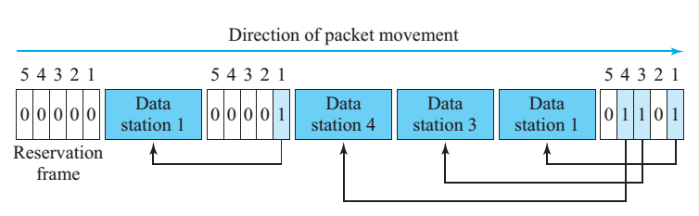
Controlled Access….
Reservation
In the following figure shows a situation with five stations and a five-mini slot reservation frame. In the first interval, only stations 1, 3, and 4 have made reservations. In the sec­ond interval, only station 1 has made a reservation [1].
Fig 4: Reservation access method

Slide 24
Controlled Access….
Polling
Polling works with topologies in which one device is designated as a primary station and the other devices are secondary stations.
All data exchanges must be made through the primary device even when the ultimate destination is a secondary device.
The primary device controls the link; the secondary devices follow its instructions.
It is up to the primary device to determine which device is allowed to use the channel at a given time. The primary device, therefore, is always the initiator of a session [1].

Slide 25
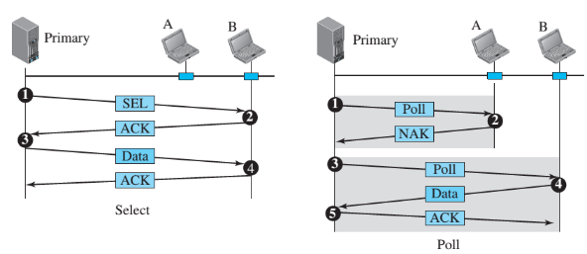
Controlled Access….
Polling….
If the primary wants to receive data, it asks the secondaries if they have anything to send; this is called poll function. If the primary wants to send data, it tells the secondary to get ready to receive; this is called select function.
Fig 5: Select and poll functions in polling access method

Slide 26
Controlled Access….
Token-passing method
In the token-passing method, the stations in a network are organized in a logical ring. In other words, for each station, there is a predecessor and a successor. The predecessor is the station which is logically before the station in the ring; the successor is the station which is after the station in the ring.
How it works:
In this method, a special packet called a token circulates through the ring. The posses­sion of the token gives the station the right to access the channel and send its data.
When a station has some data to send, it waits until it receives the token from its pre­decessor. It then holds the token and sends its data. When the station has no more data to send, it releases the token, passing it to the next logical station in the ring.

Slide 27
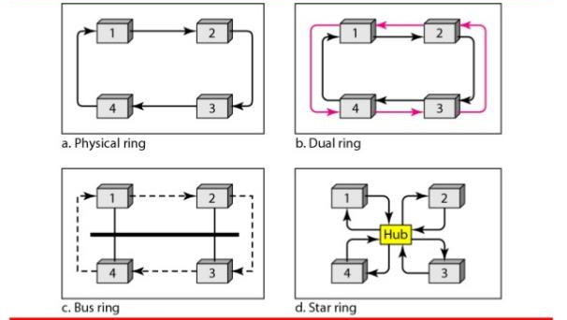
Controlled Access….
Token-passing method…
Fig 6: Logical ring and physical topology in token-passing access method [1]

Slide 28
References
[1] B. A. Forouzan, Data Communication and Networking, 5th ed., The McGraw-Hill Companies, Inc., USA, 2013, pp. 341-352.

Slide 29
Recommended Books
Data Communications and Networking, B. A. Forouzan, McGraw-Hill, Inc., Fourth Edition, 2007, USA.
Computer Networking: A Top-Down Approach, J. F., Kurose, K. W. Ross, Pearson Education, Inc., Sixth Edition, USA.
Official Cert Guide CCNA 200-301 , vol. 1, W. Odom, Cisco Press, First Edition, 2019, USA.
CCNA Routing and Switching, T. Lammle, John Wily & Sons, Second Edition, 2016, USA.
TCP/IP Protocol Suite, B. A. Forouzan, McGraw-Hill, Inc., Fourth Edition, 2009, USA.
Data and Computer Communication, W. Stallings, Pearson Education, Inc., Tenth Education, 2013, USA.

